Slide 1
The Graphical User Interface
HCI – Chapter 2

Slide 2
The GUI
An User Interface is a collection of techniques and mechanisms to interact with the user.
In Graphical User Interface, the primary interaction mechanism is a pointing device, of some kind, electronic equivalent to hand.
User interacts with a collection of elements, called objects. These can be seen, heard, touched or perceived in some manner.
Actions can be performed on objects.

Slide 3
Popularity of Graphics
Invention of graphics revolutionized UI.
With 3D buttons, pop-up messages and drop-down menus, UI gives user the feel of being a part of the system itself.
Permits various levels of customization.
Faster information transfer between computers and users.
Allows images in UI, which captures more human attention than text.

Slide 4
Concept of Direct Manipulation
The system is portrayed as an extension of the real world.
Continuous visibility of objects and actions.
Actions are rapid and incremental with visible display of results.
Incremental actions are easily reversible.
Earlier direct manipulation systems were text based. E.g., ledgers could be stored, viewed, edited or reversed as required.

Slide 5
Limitations of Direct Manipulation
Operation may be difficult to conceptualize in the graphical system.
Graphics capability of the system may be limited.
Difficult for people to learn and remember all the necessary operations and actions.

Slide 6
Indirect Manipulation
Substitutes text with symbols, and typing with pointing.
Most UI are combination of direct and indirect manipulation.
Which style of interaction – direct, indirect or combination – is best, for whom, under what conditions, is decided by the designer.

Slide 7
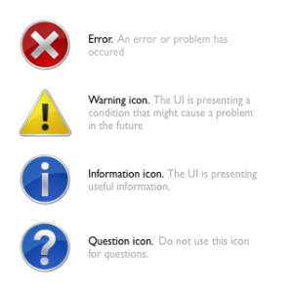
Advantages of Graphical Systems
Symbols recognized faster than text.
Faster learning, use and problem solving.
Easier remembering.
More natural.
Fosters more concrete thinking.
Provides context.
Increased feeling of control.
Immediate feedback.

Slide 8
Advantages…
Easily reversible actions.
Fewer errors.
Less anxiety concerning use.
More attractive.
Replaces national languages.
Easily augmented with text displays.
Low typing requirements.
Smooth transition from command language system.

Slide 9
Disadvantages of Graphical System
Greater design complexity.
Learning still necessary.
Lack of experimentally-derived design guidelines.
Inconsistencies in technique and terminology.
Not always familiar.
Human comprehension limitations.

Slide 10
Disadvantages …
Production limitations.
Few tested icons exist.
Inefficient for touch typists.
Not always the preferred style of interaction.
Increased chances of clutter and confusion.
May consume more screen space.
Hardware limitations.

Slide 11
Characteristics of GUI
Sophisticated visual presentation.
Pick-and-Click interaction.
Restricted set of interface options.
Visualization
Object orientation
Properties/ attributes of objects.
Actions.
Application versus Object or Data Orientation
Views
Concurrent performance of functions.

Slide 12
The Web user interface
Navigation and presentation of information.
Well structured and easy to use.
“Back” and “Forward” buttons.
Expertise of the end user is unknown.
Some level of standardization.

Slide 13
GUI v/s web page design …
Features | GUI | Web
Devices | User hardware variations limited. User hardware characteristics well defined. Screens appear exactly as specified. | User hardware variations enormous. Screen appearance influenced by hardware being used.
User Focus | Data and applications | Information and navigation
Data/Information | Typically created and used by known and trusted sources. Properties generally known Typically placed into system by users or known people and organizations Typically organized in a meaningful fashion A notion of private and shared data exists | Full of unknown content Source not always trusted Often not placed onto the Web by users or known people and organizations Highly variable organization Privacy often suspect

Slide 14
GUI v/s web page design …
User Tasks | Install, configure, personalize, start, use, and upgrade programs. Open, use, and close data files. Fairly long times spent within an application. Familiarity with applications often achieved. | Link to a site, browse or read pages, register for services, participate in transactions, fill out forms, download and Movement between pages and sites very rapid. save things. Familiarity with many sites not established.
User’s Conceptual Space | Controlled and constrained by program. | Infinite and generally unorganized.
Response Time | Nearly instantaneous | Quite variable, depending on transmission speeds, page content, and so on. Long times can upset the user.
Interaction | Interactions such as clicking menu choices, pressing buttons, selecting list choices, and cut/copy/paste occur within context of active program. | Basic interaction is a single click. This can cause extreme changes in context, which may not be noticed.

Slide 15
GUI v/s web page design …
Presentation Elements | Windows, menus, controls, data, toolbars, messages, and so on. Many transient, dynamically appearing and disappearing. Presented as specified by designer. Generally standardized by toolkits and style guides. | Two components, browser and page. Within page, any combination of text, images, audio, video, and animation. May not be presented as specified by the designer— dependent on browser, monitor, and user specifications. Little standardization.
Context | Enables maintenance of a better sense of context. Restricted navigation paths. Multiple viewable windows. | Poorer maintenance of a sense of context. Single-page entities. Unlimited navigation paths. Contextual clues become limited or are difficult to find.

Slide 16
GUI v/s web page design …
Navigation | Through menus, lists, trees, dialogs, and wizards. Not a strong and visible concept. Constrained by design. Generally standardized by toolkits and style guides. | Through links, bookmarks, and typed URLs. Significant and highly visible concept. Few constraints, frequently causing a lost “sense of place.” Few standards. Typically part of page design, fostering a lack of consistency.
Visual Style | Typically prescribed and constrained by toolkit. Visual creativity allowed but difficult. Little significant personalization. | Fosters a more artistic, individual, and unrestricted presentation style. Complicated by differing browser and display capabilities, and bandwidth limitations. Limited personalization available.
System Capability | Unlimited capability proportional to sophistication of hardware and software. | Limited by constraints imposed by the hardware, browser, software, client support, and user willingness to allow features because of response time, security, and privacy concerns.

Slide 17
GUI v/s web page design
Task Efficiency | Targeted to a specific audience with specific tasks. Only limited by the amount of programming undertaken to support it. | Limited by browser and network capabilities. Actual user audience usually not well understood. Often intended for anyone and everyone.
Reliability | Tightly controlled in business systems, proportional to degree of willingness Internet service providers, to invest resources and effort. | Susceptible to disruptions caused by user, telephone line and cable providers, hosting servers, and remotely accessed sites.
Consistency | Major objective exists within and across applications. Aided by platform toolkit and design guidelines. Universal consistency in GUI products generally created through toolkits and design guidelines. | Sites tend to establish their own identity. Frequently standards set within a site. Frequent ignoring of GUI guidelines for identical components, especially controls.

Slide 18
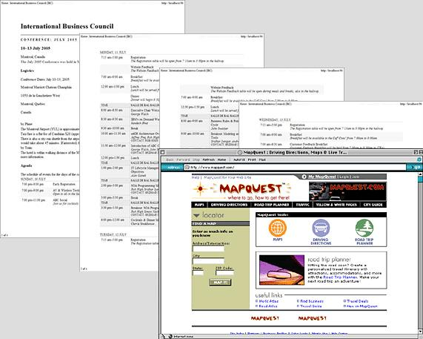
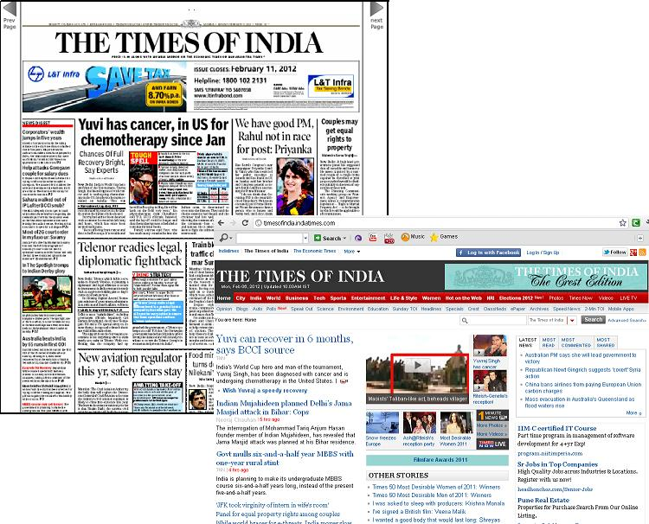
Printed Pages v/s Web Pages
Page Size
Page rendering
Page layout
Page resolution
User focus
Page navigation
Interactivity
Page independence

Slide 19
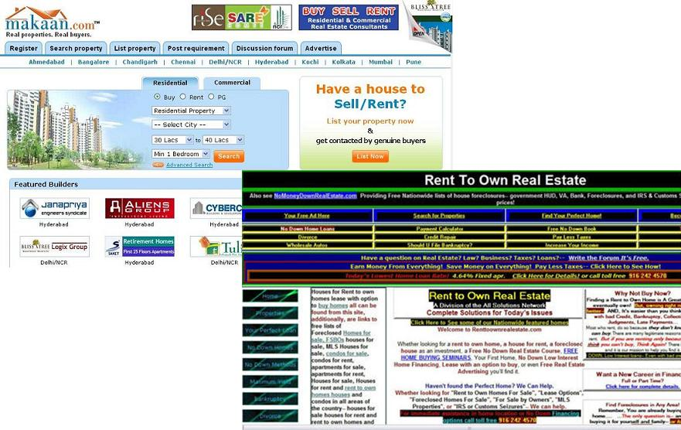
Principles of UI Design
Aesthetically pleasing
Clarity
Compatibility
User
Task
Product
Comprehensibility
Configurability
Consistency
Control
Directness

Slide 20


Principles contd…
Efficiency
Familiarity
Flexibility
Forgiveness
Predictability
Recovery
Responsiveness
Simplicity
Transparency
Trade – Offs

Slide 21
questions
What are the advantages of GUI?
Explain the concept of direct manipulation.
List and explain the characteristics of GUI.
Compare GUI with Web Interface design.
What are the principles of UI design?

